Slide 1
CS461 Senior Capstone
R. Hayden Anderson & Kyle Prouty

Slide 2
ROUS Fall Progress Report

Slide 3
Introduction
Project Purpose
Framework Design
Goals
Current Progress
Week by week summary
Backlog
Problems

Slide 4
Purpose
The framework being developed will create a network of nodes that will communicate by broadcasting simple messages to each other. Nodes will use network protocols to pass these messages in order to self organize on an objective. Users will be able to input print job objectives into our framework and view the results from a graphical user interface.
Overall the rationale for the entire framework is to have a collection of loosely coupled nodes that can self organize to accomplish a print job. This framework will be robust in the face of any nodes that become untrusted. Nodes in this framework will communicate with each other using simple messages over wireless network protocols.

Slide 5
Framework Design
The ROUS framework being implemented will be organized into three parts: software, hardware, and a graphical user interface. These separate pieces will work together to make up the overall framework. This system will have the functionality to be given a print job objective, organize on that objective, and then accomplish that print job objective. In this framework all communication happens by broadcasting simple messages. A user interface will provide users, observers, and administrators the ability to interact with the framework. The framework will contain a network of nodes that communicate by broadcasting simple messages.

Slide 6
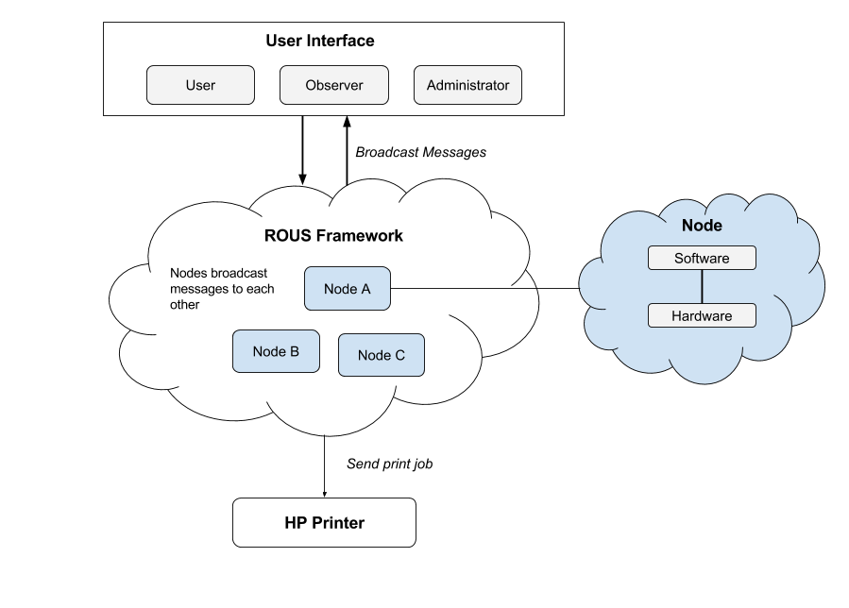
Framework Design

Slide 7
Goals
Enable nodes to self organize on a structured objective
Allow an objective to be input
Allow a source of mistrust to be input
Output readable configuration data
Output readable system state data
Output readable results of objective
Automatically validate and connect to authorized nodes
Allow nodes to share objectives with each other
Framework state changes based on the input of a source of mistrust
Have a user interface
Offer a print service

Slide 8
Current Progress
Over winter break and the ten weeks of winter term, most of our time will be spent on the development of our framework. Now that we have a clear view of the requirements and have set how the initial design should look, it is time to start implementation. Using the design document as a starting point, we will begin the process of coding and implementation.

Slide 9
Backlog
Be able to broadcast message
Broadcast objective
Language keywords
Implement language
Implement "and" in language
Implement "or" in language
Task bidding
Declare bid winner
Task bidding: ties = rebid
Task bidding: ties = only top tied nodes rebid
Carryout objective
Node can print to a printer
GUI base
GUI shows network
GUI insert gets file
GUI can broadcast to network
GUI for administrator
GUI for observer
GUI for user
GUI can receive messages

Slide 10
Problems
Original Ambiguity
Group Dynamics

Slide 11
Solutions
Solving Ambiguity
Talking with Lonnie
Bouncing Ideas
Finding our Strengths and Interests
Solving Group Dynamics
Conversing with TA, Ombuds, Teachers, and advisors
Using techniques taught by Ombuds
Using techniques told to try by all of the advisors

Slide 12
Retrospective
Over the course of fall term our team has made a lot of progress on the project.
We have:
Developed a problem statement
Finalized the project's requirements,
Looked at relevant technologies that could be used to implement the project
Discussed in detail how are project is designed

Slide 13
Week 1
Reviewed project options
Made ordered lists of our favorite projects
Thought about our personal futures

Slide 14
Week 2
Picked our projects
Met our groupmates
Met our client
Narrowed project ambiguity a little

Slide 15
Week 3
Decided on project name
Worked on our problem statement
Agile development

Slide 16
Week 4
Finalized problem statement
Did first weekly review with client
Narrowed down project even more
HP campus tour

Slide 17
Week 5
Requirements rough draft
Fine tuned problem statement
Started to get external help for persisting group dynamic issues

Slide 18
Week 6
Lots of requirements document work
Reduced the fluff
More group dynamic mitigation

Slide 19
Week 7
Finalized requirements document
Started individual tech review
Split up the project into parts
Split parts among us

Slide 20
Week 8
Design meeting with Lonnie
Worked on Design document
Lots of discussion on how the project will work and ways to achieve our goals

Slide 21
Week 9
Clarifying with Lonnie
Discussed bidding system
Thanksgiving

Slide 22
Week 10
Design document feedback
Implementing feedback
Clarifying questions

Slide 23
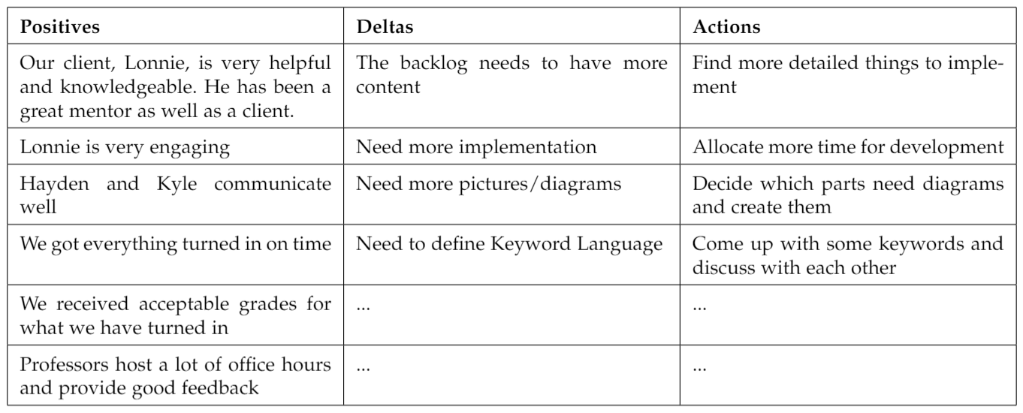
<Reflection Table>

Slide 24
Thank You

